Slide 1
SOCIAL BARRIERS (INDIA)
Presentation By:-
1. Shivashish Prasad
2. Aman Garg
3. Ashish Kumar
4. Ajinkya Bedekar
5. Javid Akhtar
6. Muskan Gupta

Slide 2
VARIOUS QUESTIONS………….
What are social barriers?
How a social barrier formed?
Language difference.
Stereotypes.
Difference of opinion.
Different lifestyle.
People affected due to social barriers.
Students
Working class in transferrable jobs
Negative effect and the intensity of social barriers.
Solution to Social Barriers
Sources

Slide 3

WHAT ARE SOCIAL BARRIERS?
Social barriers are barriers to entry which are created by the culture of the community, i.e. people's behaviour towards newcomers or others in general.
Social barriers are things that people create as they find it difficult to relate to another type of person. They don 't really exist but are just reserves people have about other people therefore they have little or nothing to do with them.

Slide 4
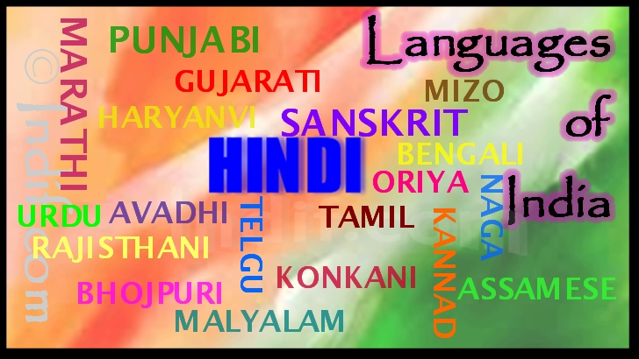
HOW ARE SOCIAL BARRIER FORMED?
Language difference
India doesn’t have a national language but 22 official languages.
More than 150 languages have sizable speaking population.

Slide 5
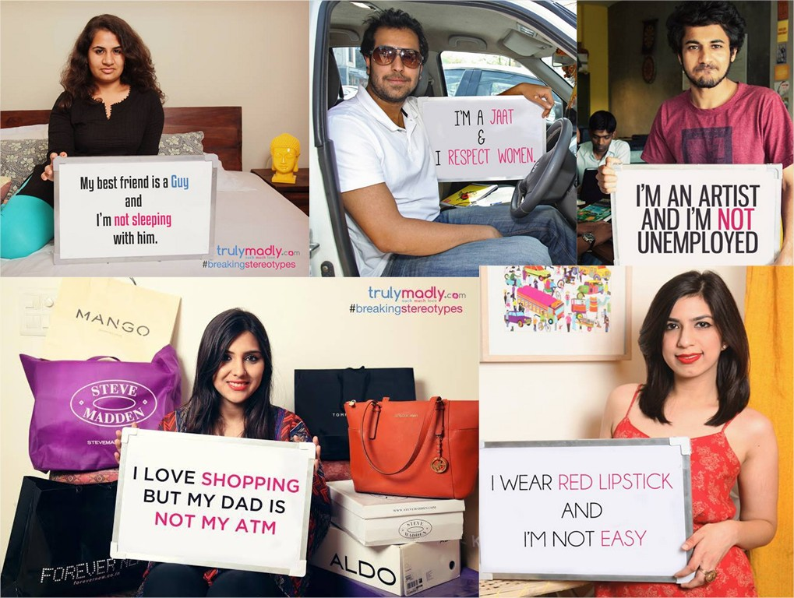
2. Stereotypes
Social Stereotyping is the process of ascribing particular behavioral or attitudinal traits (although it can also often also include physical traits) to individuals on the basis of their apparent connection to, or membership of a group or class.

Slide 6
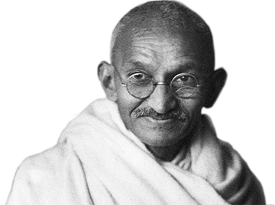
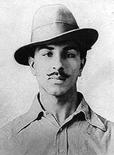
3. Difference of opinion
When a clash of opinion arises between two different societies, a social barrier is bound to occur.

Slide 7
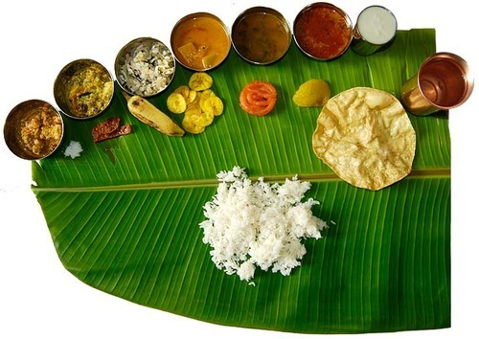

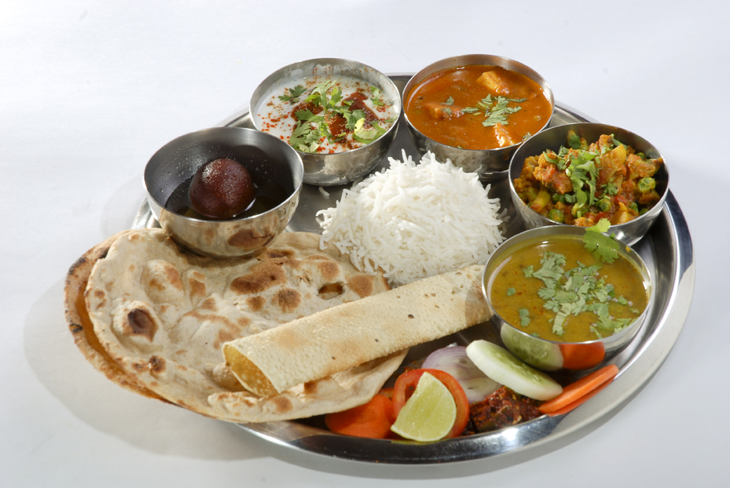
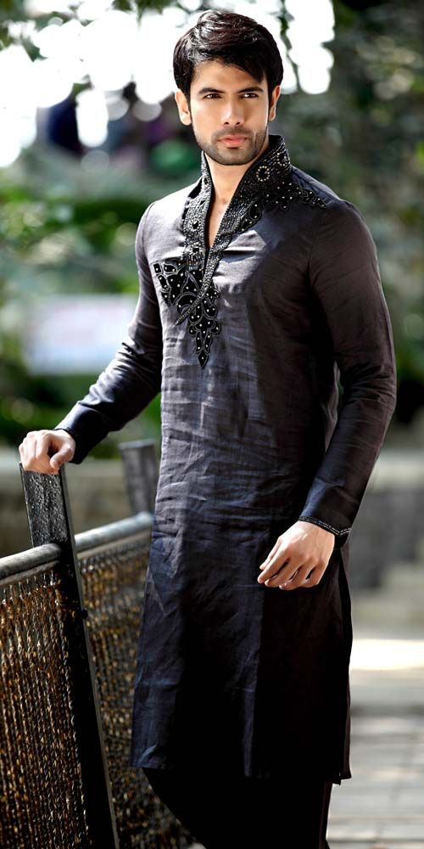
4. Different lifestyle
In southern India the food is entirely different to what is served in north India
The dress code way of speaking way of greeting and even way of working is different in all parts of india giving rise to groupism – Again giving rise to social barriers

Slide 8
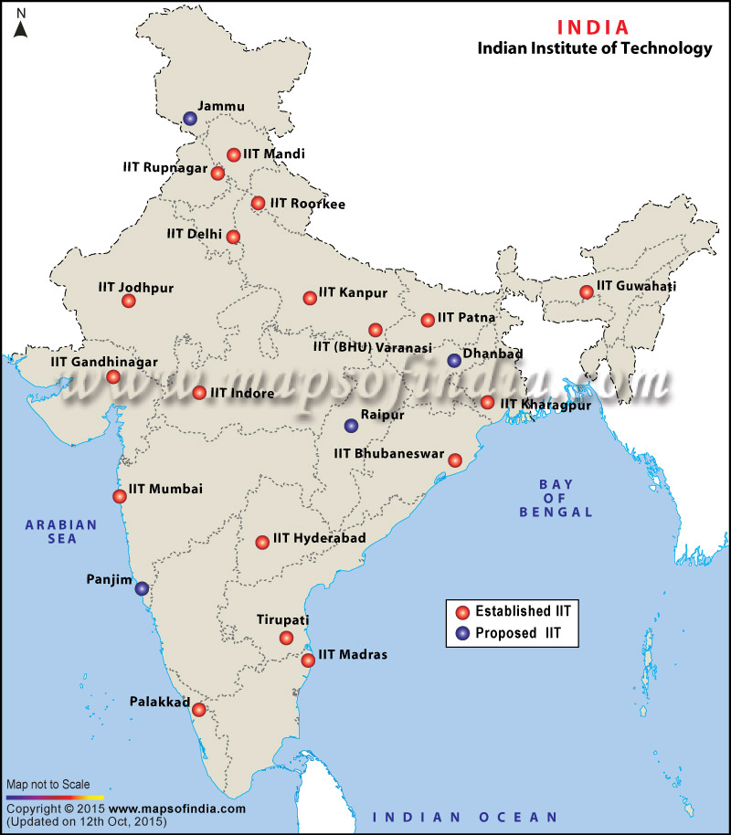
PEOPLE AFFECTED DUE TO SOCIAL BARRIER..
Students
Best IITs and IIMs are not everywhere, hence a student may have to go to an unknown part of the country to get his education.
Problems faced:
Finding himself in an entirely alien surroundings created by social barrier it reduces the moral and the enthusiasm of the student.
This barrier creates groupism which restricts the growth of that student.
This some times even lead to violence.

Slide 9

2. Working class in transferrable jobs
Reservation in jobs – People have a biased opinion about the ones who are reserved
Again if a person from one community enters a workplace in another state or city faces discrimination
Your academic qualification and positon in company

Slide 10

NEGATIVE EFFECT AND INTENSITY OF SOCIAL BARRIER
Reduced performance in workplace college and everywhere else.
It hampers the unity of the people making it more vulnerable to an attack.
Sometimes even results in violence.

Slide 11
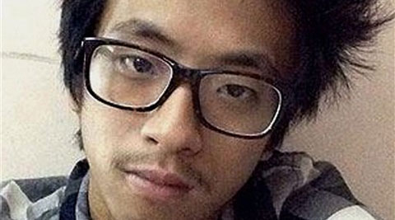
Violence
A teenage student from Arunachal Pradesh died in the city on Thursday, on the morning after he was beaten by a group of men led by the owner of a paneer shop in south Delhi’s Lajpat Nagar market. -29th January 2014

Slide 12
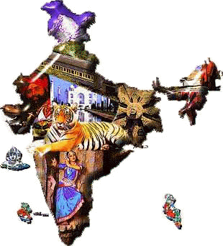
UNITED WE STAND, DIVIDED WE FALL

Slide 13
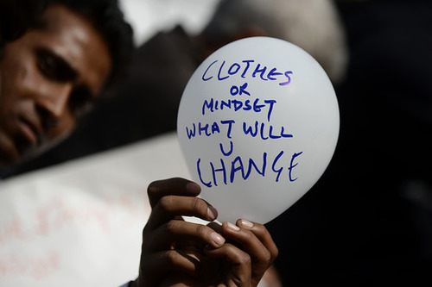
SOLUTIONS TO SOCIAL BARRIERS
1 Change your mentality

Slide 14
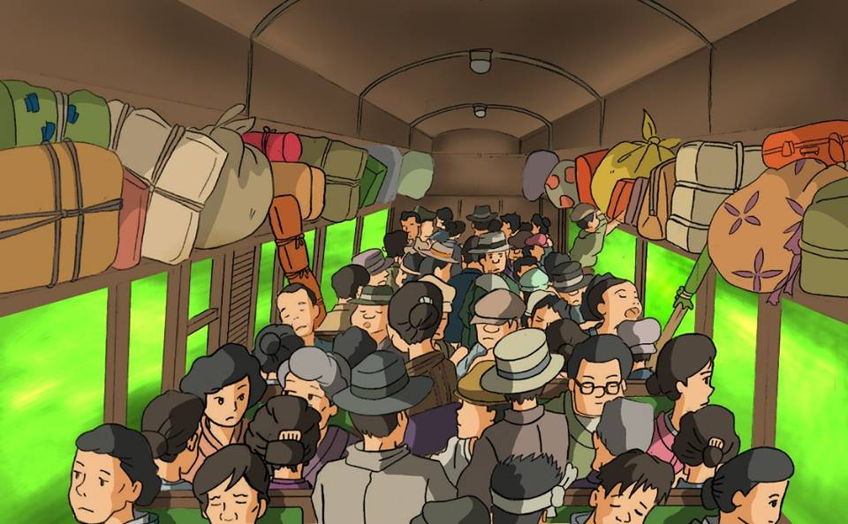
Learn to Adjust

